Slide 1


SAP UI5 & FIORI with OData TRAINING
Anubhav Oberoy
Day – 7

Slide 2

Agenda – Day 7
Hook methods in controller
Concept of binding in UI5
Expression Binding
Binding Modes
Aggregation Binding
Element Binding
Concept of Base Controller
XML Model
Resource model in UI5
Multi-Language Support of the App
Formatter in UI5
User Experience and User Interface
Introduction to Fiori
Structure of a fiori Project

Slide 3
Hook Method of Controller
onInit()
onBeforeRendering()
It is a function which gets called immediately after UI5 creates the object of our controller. It is like constructure of a class. We can use this to initialize our class variable
It is a method which gets called MULTIPLE times, Before every time the view is displayed to the user. We can use this method for pre-processing on a view.
IN
BR
EX
AR
onExit()
onAfterRendering()
It is a function which gets called before the instance of our controller gets destroyed. It is like destructor of a class.
We can use this to write clean-up code.
It is a method which gets called MULTIPLE times, After every time the view is displayed to the user. This method can be used to show effects to the user.

Slide 4

Exercise: Models and Model Binding
Model Exercise 1: Model Creation code within controller
In this exercise we will create a JSON model using a JavaScript Object.
After Creating the model, we will bind the model to the XML view in a Simple Form
Exercise code/resource:
MyView.controller.js
MyView.view.xml
Model Exercise 2: Model Creation code in models.js file.
In this exercise we will create a model.js file, In that file we will write code to create the model dynamically.
After that we will create two model and bind them with the form and on click of a button the model will be flipped.
Exercise code/resource:
MyView.controller.js
MyView.view.xml
models.js
mydata.json
mydata2.json

Slide 5

Concept of Binding in SAP UI5
Data binding is the process that establishes a connection between the application UI and business logic.
It is a bridge between a binding target and a binding source.
Sap ui5 provides three binding options
Property Binding
Expression Binding
Aggregation Binding
Element Binding
Property Binding:- When we bind property of a UI control, to the address of the model, this is called property binding. E.g., value property of Input control was connected to /emp/empId
Ex:-
In XML view:- <Text text=“{/emp/empId}” ></Text>
In controller: - this.getView().byId(“controlId”).bindProperty(“text”, ‘/emp/empId’);

Slide 6
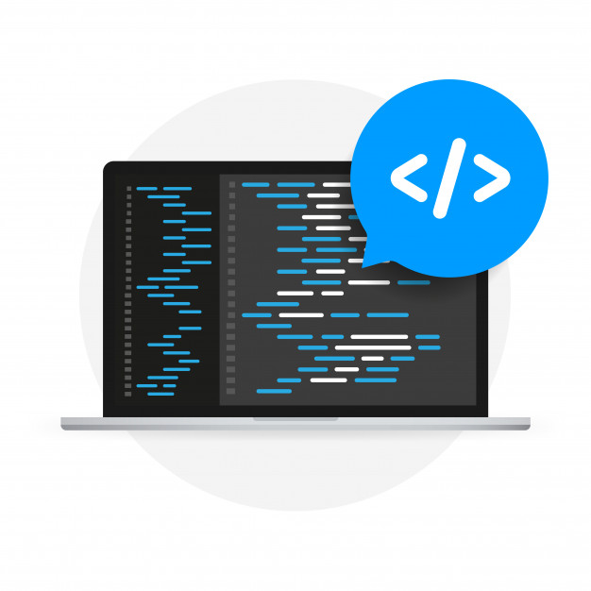
Expression Binding
Expression binding : - When we bind an Expression ({= condition ? true : false}) with the property of a control rather binding value to a property, this is called expression binding.
If we need some calculation on model data or some sort of comparison, then expression binding is useful.
Syntax:
numberState = “{= ${path} > value ? ‘conditionForTrue’ : ‘ConditionForFalse’ }”
Use Case of Expression Binding
My Manager want to make salary field grayed out (read-only) when employee is anubhav
If The Employee Name is Anubhav, Gray out Salary field.
Condition – if employee name = Anubhav
Outcome – make field gray out
Target – Salary field
Note: To use expression binding in our application we need to add line in the bootstrap code of UI5 in index.html
data-sap-ui-bindingSyntax="complex"

Slide 7

Exercise: Expression Binding
In this exercise we will see the example of both property binding and expression binding.
In this file we also see that how to get data form the file in the model.
Exercise code:-
MyXML.controller.js
MyXML.view.xml
index.html

Slide 8
Binding Modes
There are basically three modes of binding data in SAPUI5.
One-way binding – Here, the data is transported in one direction only, i.e., from the model, through the binding instance to the consumer (usually the property of a control), but never in the other direction. Any change done on the model data from the front end is not affected to the model. All the data changes are reflected only on the controls.
Two-way binding – Here all input changes done from front end controls are reflected on the model and the backend database. SAPUI5 automatically handles the transport of data both from the model to the controls and back from the controls to the model.
One-time binding – Here all data will be bound from model to view just once. After that, the connection is no more set.
Data
Data
Model
View
Model
View
Data
One-way binding
Two-way binding
Data
Data
Data
Model
View
Model
View
One-Time binding

Slide 9
Aggregation Binding
When we bind the aggregation of a control with the entityset of data model, it is called aggregation Binding.
The parent control (e.g. Table) is bound to the EntitySet path which is called absolute path and the child of the parent Control (e.g. Columns) are connected to the child properties of the EntitySet is called relative path.
In aggregation binding, based on your model data, as many child controls will be created automatically.
Every Event of UI5 will trigger the eventHandler and we will get the Event Object as part of the event Handler. Depending on the event, the event handler object will have different parameters.
Use Case of Aggregation Binding
If we want to show a list or some data in tabular format, we need to bind a group of data. In such a case we will use aggregation binding.
Absolute path
{
“empTab”: [
{
“empId”: 50,
“empName”: “Jay”,
“salary”: 9500
}
]
}
Table = rows= {/empTab}
Emp Id | Emp Name | Salary
{empId} | {empName} | {salary}
Relative Paths

Slide 10

Exercise: Table in UI5 & Aggregation Binding
In this exercise we will create a table and load the data of some employees in it.
We will see how to use different controls in a table to represent data.
Exercise code/resource:-
MyView.view.xml
MyView.controller.js
mydata.json

Slide 11

Exercise - Dynamic Aggregation Binding
In this Exercise we will bind the rows property is the table dynamically form the column.
Exercise code/resources:
MyView.view.xml
MyView.controller.js

Slide 12
Element Binding
Element binding is useful for containers and layouts containing other controls. All these child controls would be required to use properties of the same model object or model node, then element-binding is preferable.
An element to be bound to an object in the Model can be achieved by Element binding.
Use case:- On Select of a row in the table show the row data in a form.
Table
/empTab/0
/empTab/1
/empTab/2
Emp Id | Emp Name | Salary
{empId} | {empName} | {salary}
Element 0
Element 1
Element 2
Simple Form
Field 0
/empId
All the content of Row 1 in the table is bind to all the fields in the form
Field 1
/empName
Field 2
/salary

Slide 13

Exercise: Element Binding
In this exercise we will use element binding to bind the data of a selected row with the form.
Exercise code/resources:-
MyView.view.xml
MyView.controller.js

Slide 14
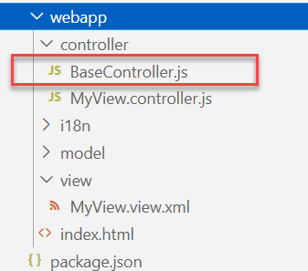
Concept of Base Controller in UI5
Base Controller:- A base controller is a controller with basic functionalities from which the other controllers in your SAPUI5 application inherit.
The base controller holds basic functionalities that are used across multiple controllers.
The base controller itself is just another JavaScript file and it does not have the .controller prefix. Just BaseController.js and not BaseController.controller.js.
The base controller goes in the controller folder in your SAPUI5 application folder structure:
sap/ui/core/mvc/Controller
x
BaseController
Template
x
Controller 1
x
Controller 2
x
Controller 3
x
Controller 4
View 1
View 2
View 3
View 4

Slide 15

Exercise: Base Controller
In this exercise we will create a new BaseController.
Along with that we will see how to load data to a model from a file.
Exercise code/resources: -
MyView.view.xml
MyView.controller.js
BaseController.js

Slide 16
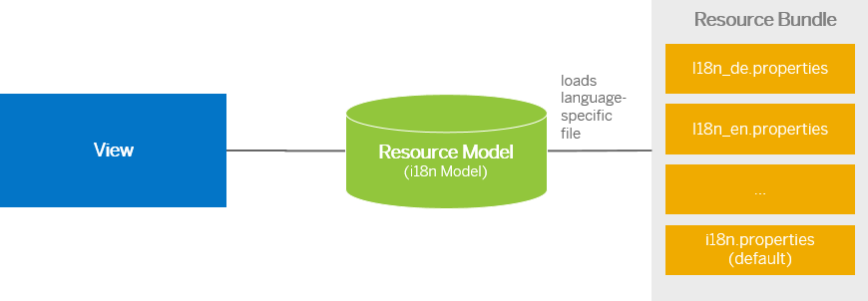
Resource Model
We build software for international audience, we cannot just hardcode every screen element in English, if it requires multi-lingual support, we need to add resource model.
i18n → Internationalization
Create resource bundle which includes label field
The name of the file must be i18n.properties for default labels
And i18n_langcode.properties for different languages
Set The model
For more information about i18n you check the link
https://openui5.hana.ondemand.com/1.34.9/docs/guide/831039835e7c4da3a8a0b49567573afe.html
We can change the language of the app by adding ?sap-language=language_code at the end of the URL of the app. Example for Hindi we will write ?sap-language=hi

Slide 17
Exercise: Resource Model
In this exercise we will see how the language of an app is changed using the i18n file.
We have to create a folder ‘i18n’ in webapps folder and in the folder, we have to add files named ‘i18n.properties’ and one another file named according to the language we want. For example:- for Hindi language the file is named as ‘i18n_hi.properties.
Along with that we will add a delete button on top of the table to delete the record of an employee from the model.
Exercise Code:-
MyView.view.xml
MyView.controller.js
i18n.properties
i18n_hi.properties

Slide 18
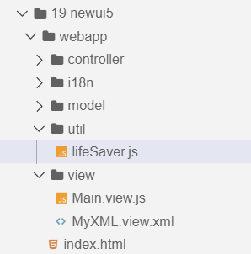
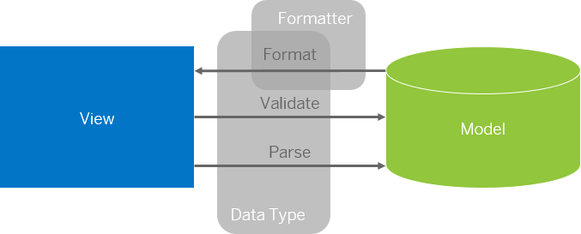
Formatter in SAP UI5
Formatters are used to define the formatting of data on the UI while data types work in both directions: they format the data on the UI and parse and validate user input that is entered.
Formatter is a function; This function gets called JUST Before the binding takes place with the view.
Formatter file is placed in a folder in webapp folder, and the file can be named anything with the .js extension.
Formatter

Slide 19
Exercise: Formatter
In this exercise we are going to currency code in the table.
We will convert the currency code into its corresponding currency symbol.
We will achieve this by using a formatter function.
Exercise Code:-
MyView.view.xml
MyView.controller.js
lifeSaver.js

Slide 20
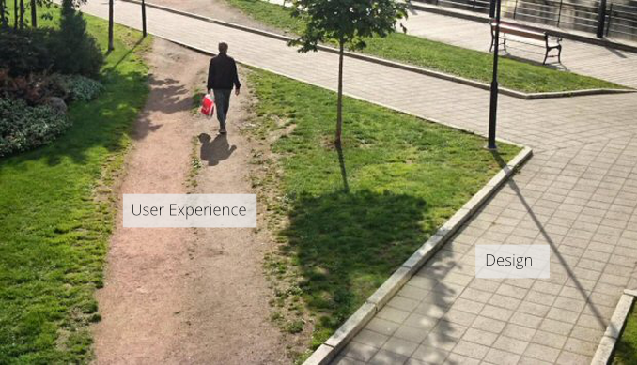
User Experience v/s User Interface
User interface is developer oriented. This is purely technical. We can change UI any number of times.
User experience is user oriented. It is psychological. We cannot change UX.

Slide 21
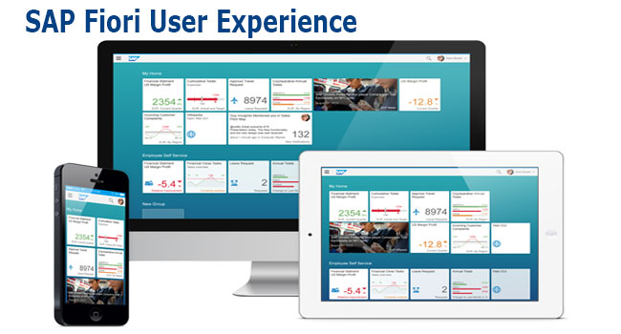
What is Fiori?
SAP Fiori is the user interface or user experience (UX) that supplements and can replace the SAP GUI. This streamlined application uses tiles to encapsulate standard tasks, such as approving purchase requisitions, viewing sales orders, and approving timesheets.
Fiori is SAP’s new user experience. These are standard apps delivered by SAP and by following the Development guidelines any one can use UI5 to create Fiori Apps.
Fiori is a streamlined application, delivering a role-based user experience that can be personalized across all lines of business, tasks and devices.
It uses tiles to encapsulate standard tasks like viewing sales orders or approving timesheets.
Fiori = UI5 + Development/Design Guidelines

Slide 22
Structure of a Fiori project
There are different folders and directory are required for setup project: webapp, Controller, models, utils ,view, Component.js, manifest.json, index.html
Structure of normal ui5 application
Index.html
View
Controller
Structure of Fiori Application
Dev.
sap/ui/core/UIComponent
Index.html
Root View
App.view.xml
Component.js
View 1
Controller 1
Container
App (pages)
View 2
Controller 2
manifest.json
App descriptor
App.controller.js
BaseController
Component.js is starting point

Slide 23
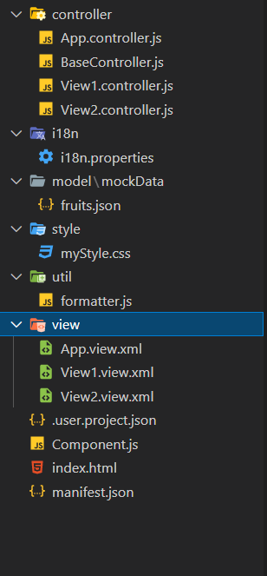
Structure of Fiori Project Files
There are different folders and directory are required for setup project
Webapp = This provides the root directory and of all files given in alias name or namespace
Controller = The controller folder contains all the controllers used by your views and might also contain additional logic files that are used by one or more controllers. The structure of the controller folder should mirror the view folder.
models = It contains .json file and object of data
utils = It is the reuse file of JS code
view = It contains all the .xml files.
Component.js = It is the starting file of our app
manifest.json = It is the application descriptor file.
Index.html

Slide 24

End of Day 7

Slide 25

Questions

Slide 26

Anubhav Oberoy

Slide 27


We’re committed to empower you to be
Most Desirable Resource
through powerful training solutions.
We build the workforce of the future.
250+
Corporate Clients
30,000+
Learners Trained
25000+
Learners Placed
FREE WEBINARS
Sign up for free webinars with industry experts every fortnight!
Enroll Now!
Contact us today!
https://anubhavtrainings.com/

Slide 28




More from AnubhavTrainings.com

Slide 29
Title
Content

